Slide 1
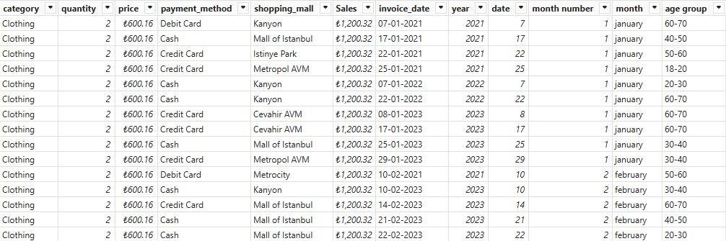
Customer Data Analysis
1.Project Overview
This project analyzes customer shopping behavior using transactional data from 1000 customers across various product categories. The goal is to uncover following
How is the shopping distribution according to gender?
Which gender did we sell more products to?
Which gender generated more revenue?
Distribution of purchase categories relative to other columns?
How is the shopping distribution according to age?
Which age cat did we sell more products to?
Which age cat generated more revenue?
Does the payment method have a relation with other columns?
How is the distribution of the payment method?
And visualize the data using Power BI , suggestions to the company.
2.Dataset Summary
-Rows:1000
-Coloumns:12
-Key Features:
Customer demographics ( Age ,Gender,CustomerId )
Purchase Details( Quantity , Category,Shopping mall ,Price,Paymentmethod ,Invoice date,Invoice number)
3.Data Analysis Using SQL
Missing Data Handling :
checked for null values in all rows and columns in table but here there is no null and missing values .
4.Data Representation Using PowerBI
Data Loading:
Imported data sets using excel file(Sql),created age_group column by customer age, sales column by using price*quantity.

Slide 2
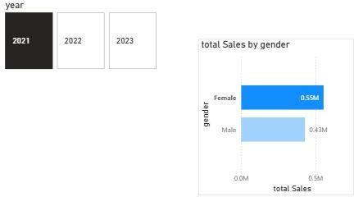
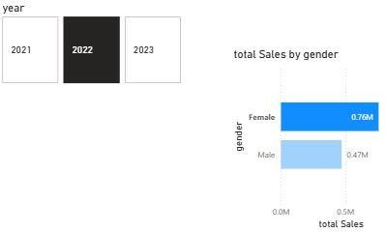
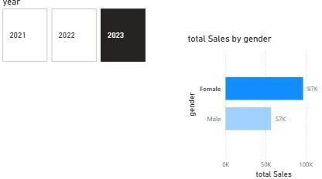
How is the shopping distribution according to gender?
From 2021,2022,2023, female customers led male customers in revenue contribution ,indicating a overall Shopping impact

Slide 3
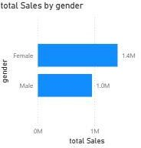
Which gender generated more revenue?
From 2021,2022,2023, female customers led male customers in revenue contribution ,indicating a overall purchasing impact
Total Revenue as Total Sales Total Sales - Female
2021-553,756.52 Turkish Libra
2022-471,142.68 Turkish Libra
2023-56,820.49 Turkish Libra

Slide 4
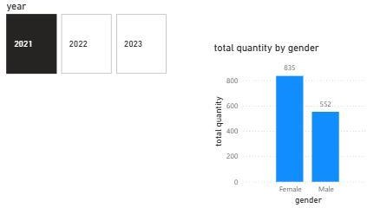
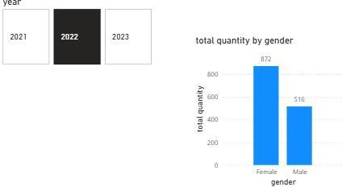
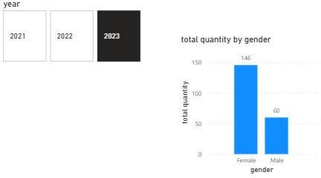
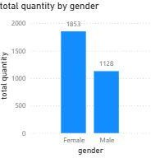
Which gender did we sell more products to?
From 2021 to 2023,Female customers consistently purchased a higher number of products compared to male customers.
Total Quantity – Female 2021-835Qty
2022-872Qty
2023-146Qty
Over All Quantity Purchased by Female 1853Qty

Slide 5
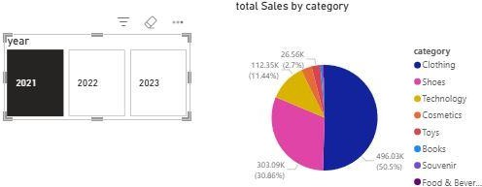
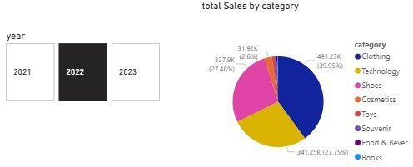
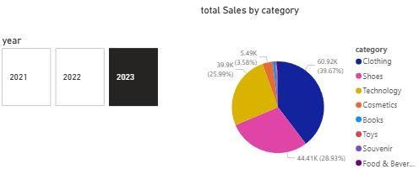
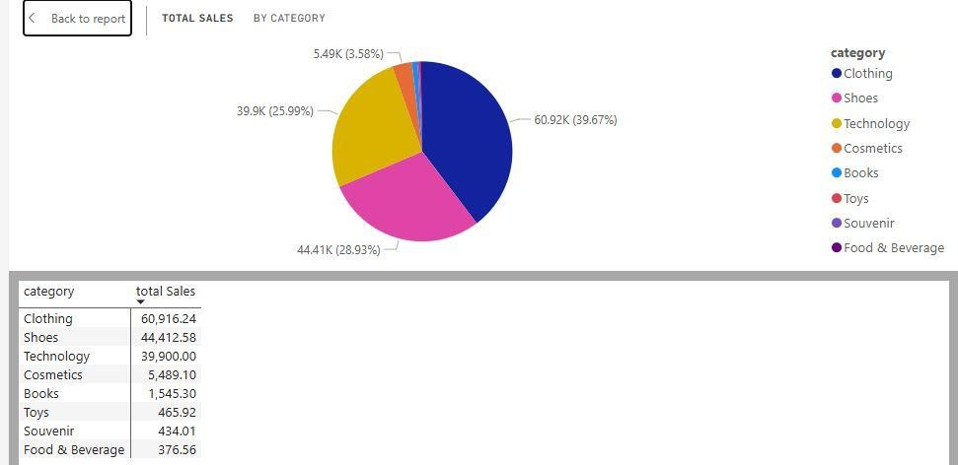
Distribution of purchase categories relative to other columns?
Across 2021,2022 and 2023, the clothing category recorded the highest product sales And second most popular category is Shoes(2021,2023)
Overall Product Category Sold- Clothing

Slide 6
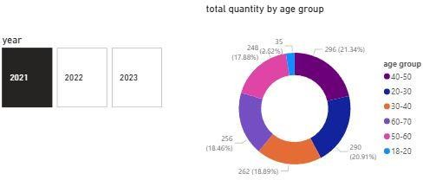
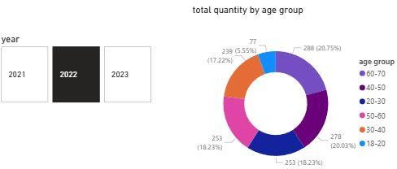
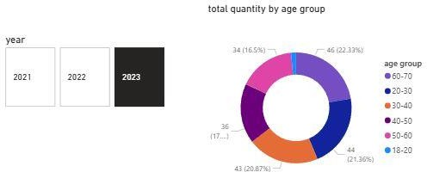
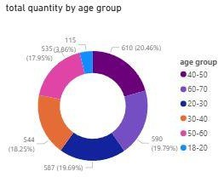
How is the shopping distribution according to age?
In 2021,the 40-50 age group contributed the highest number of purchase,however, in 2022 And 2023,the 60-70 age group accounted for highest purchase volume
Overall age group purchased

Slide 7
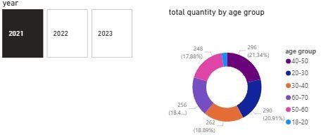
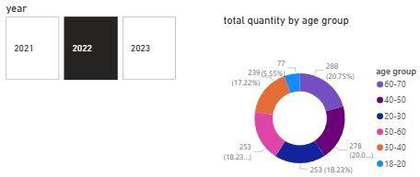
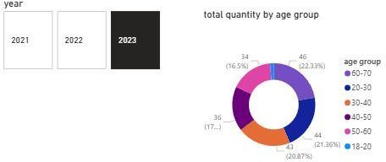
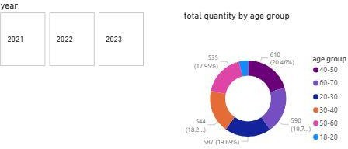
Which age cat did we sell more products to?
Customer purchasing trends show a shift from the 40-50 age group in 2021 to the 60-70 age group in 2022 and 2023,indicting increased buying activity among older customers
Over all age group by total quantity

Slide 8
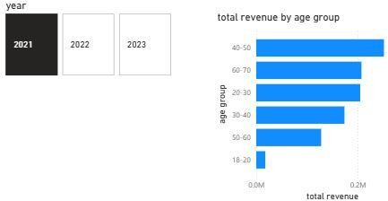
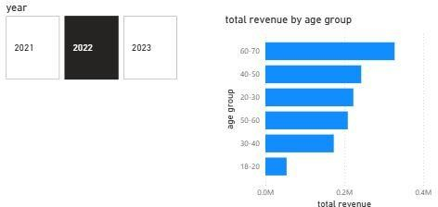
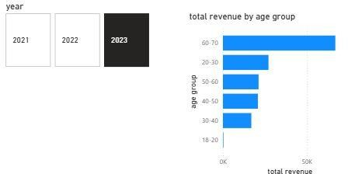
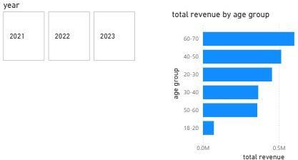
Which age cat generated more revenue?
Revenue trends indicates a shift from the 40-50 age group in 2021 to the 60-70 age group in 2022 and 2023,showing increased spending among older customers
Overall age group by revenue

Slide 9
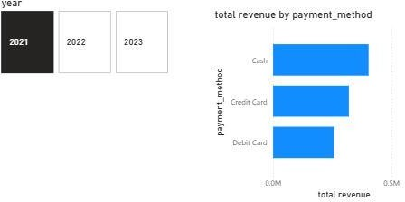
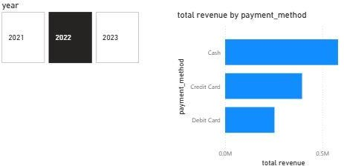
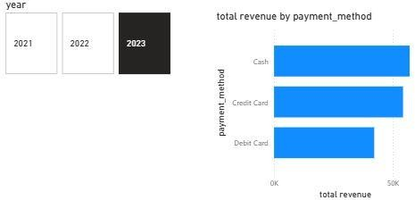
Does the payment method have a relation with other columns?
Payment analysis shows that cash was the dominant payment method ,contributing the highest share of total revenue consistently from 2021 to 2023.

Slide 10
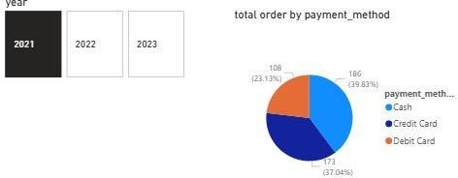
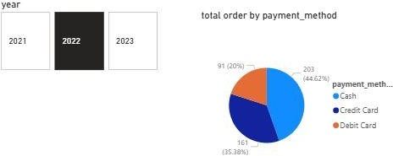
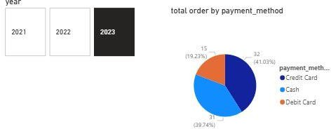
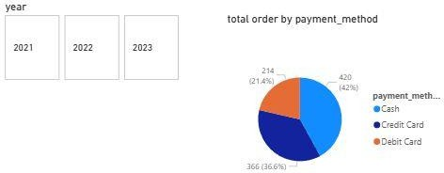
How is the distribution of the payment method?
Order payment trends shows a shift from cash dominance in 2021 and 2022 to increased credit card usage in 2023,indicating a change in customer payment preference.
Overall payment method vs total order

Slide 11
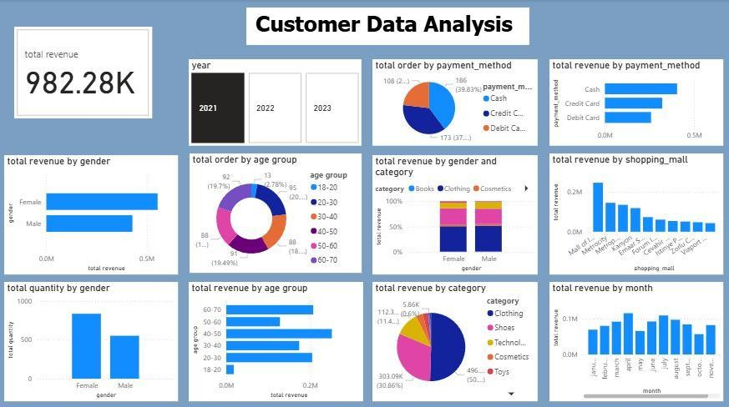
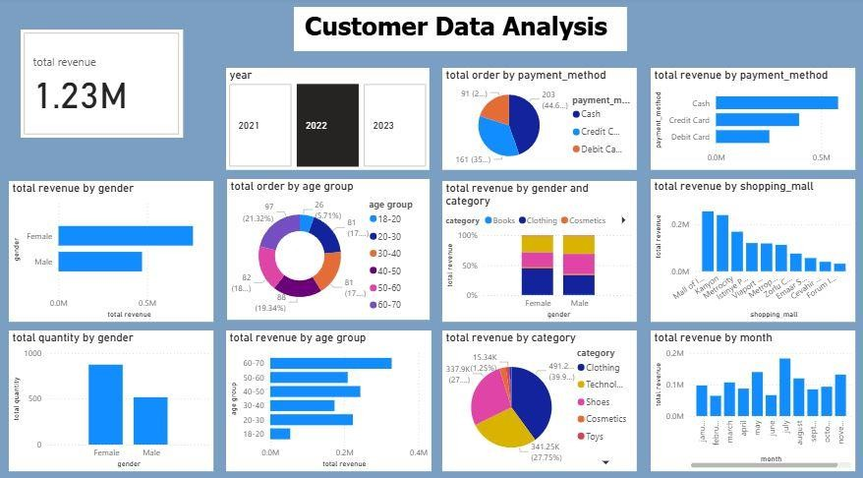
5.Over All Analysis – Power BI
2021-Analysis Report
2022-Analysis Report

Slide 12
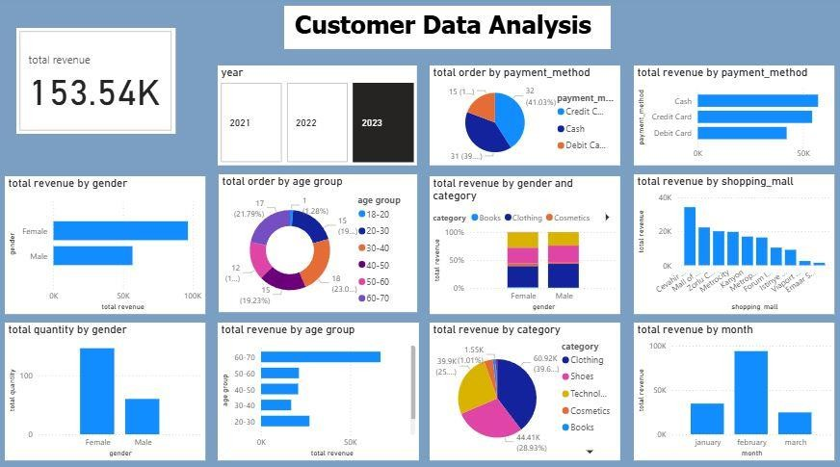
2023-Analysis Report
Revenue showed an upword trend from 982.28k Turkish Libra in 2021 to 1.23M in 2022.
In 2023,the first quarter (January to March) generated 153.54K Turkish Libra
6.My Suggestions To Company
Based on the sales analysis, I recommend expanding the product range by introducing additional items in the clothing category ,as it shows consistently high demand .Additionally ,adding
technology products and launching a shoes category could help diversify the portfolio and attract new customer segments, ultimately increasing overall revenue.
Analysis of external customer reviews for malls in Istanbul indicates recurring complaints regarding indoor smoking , leading to discomfort among non-smoking visitors. To enhance customer
experience and maintain a healthier environment ,it is recommended to establish clearly designated smoking zones, physically separated from general shopping areas.
[External Source-Mall Review]

Slide 13
7.Team Introduction Section
Project Title: PRDA-05: Customer Data Analysis Team Id: PTID-CDA-MAR-26-11139
Team Member Name: Prasanth N (Data Analyst)

